Slide 1

Project: Global EV Sales 2010 - 2024
Presented by: T. Om Prakash
Gmail : omprakashtalasila@gmail.com
Batch : 422

Slide 2
Agenda
Project Overview
Data Description
Data Cleaning & Preparation
Key DAX Measures Used
Dashboard Overview
Key Insights & Recommendations
Conclusion

Slide 3
Project Overview
This Power BI project analyzes global electric vehicle (EV) trends from 2010–2024. It explores EV adoption across regions, vehicle categories, and powertrain types. The goal is to identify key growth areas and performance trends in the global EV market.

Slide 4
Data Description
• Region – Geographic area or country reporting EV data
• Category – Type of vehicle (Cars, Buses, Trucks, 2-Wheelers,etc.)
• Parameter – Metric recorded (Stock, Sales, Energy Use, etc.)
• Powertrain – EV drivetrain type (BEV, PHEV, FCEV)
• Mode – Transport mode (Passenger, Freight, etc.)
• Year – Calendar year of data record
• Unit – Measurement unit (Vehicles, TWh, etc.)
• Value – Numeric measurement of the parameter

Slide 5
Data Cleaning & Preparation
• Verified consistency of region and category names.
• Removed duplicates and blank values in 'value' and 'year'.
• Converted text fields to numeric (for year, value).
• Created calculated columns and DAX measures for analysis.
• Built relationships between region, category, and parameter tables.

Slide 6
Key DAX Measures Used
1. Total EV Value = SUM(EV_Data[value])
2. EV Growth % = (CurrentYearValue -PrevYearValue) / PrevYearValue
3. BEV vs PHEV Share = DIVIDE([BEV Value],[Total EV Value])
4. Region Type = IF(Region IN {Europe, NorthAmerica, Japan, Korea}, 'Developed','Developing')
5. Peak Year = CALCULATE(MAX(year),FILTER(EV_Data, [Total EV Value] = [RegionMax]))

Slide 7
Dashboard Overview
Dashboard Pages:
1. Global Overview – Total EVs, Growth %, Top Regions, BEV Share
2. Regional & Category Trends – EV growth by region/category
3. Powertrain Insights – BEV vs PHEV comparison and growth trends
4. Parameter Analysis – Sales, Stock, Energy Consumption patterns
5. Time Series – Year-over-year growth and cumulative analysis

Slide 8
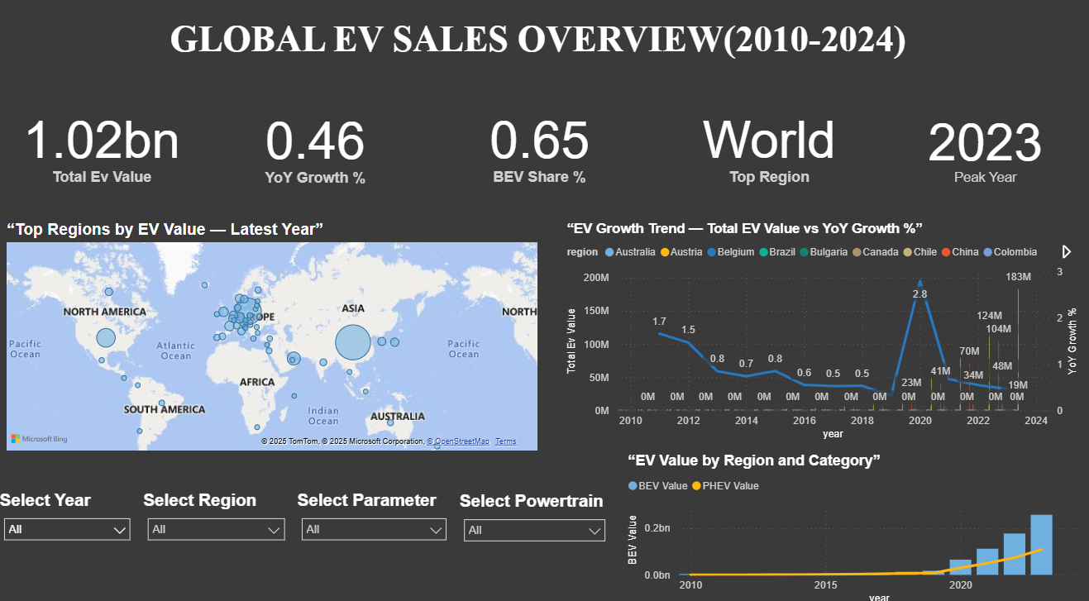
Global Overview
• Global EV growth trend from 2010–2024.
• Total EVs sold worldwide and year-over-year growth.
• Key drivers influencing global EV adoption.
• Comparison of global EV market share among major regions.
• Insights on policy, technology, and infrastructure shaping the EV landscape.

Slide 9
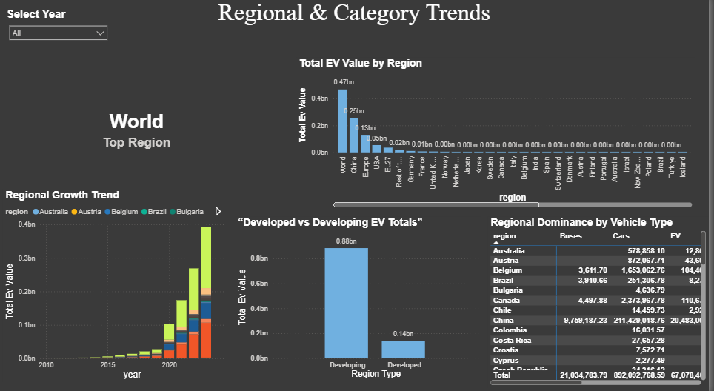
Regional & Category Trends
• Total EV value by region and year.
• Top 5 regions contributing most to EV adoption.
• Comparison between developed and developing regions.
• Category-level EV penetration across regions.

Slide 10
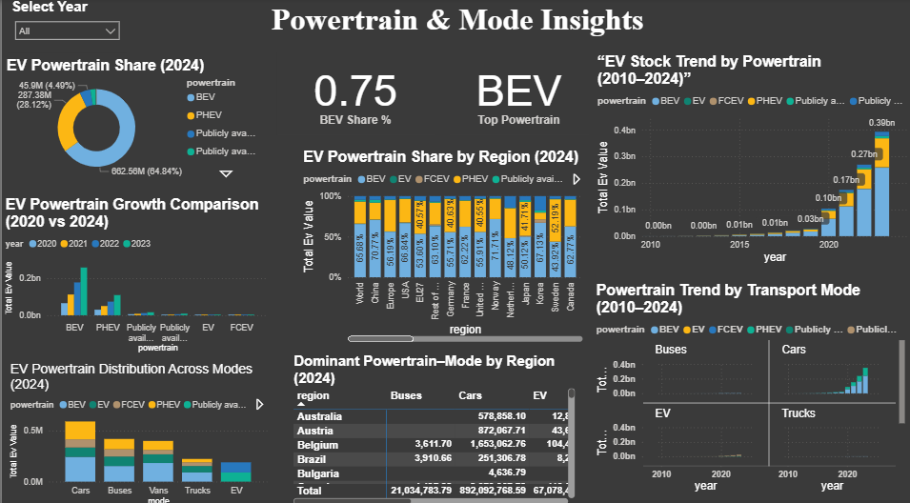
Powertrain & Mode Insights
• Distribution by powertrain (BEV, PHEV, FCEV).
• Powertrain growth trends globally.
• Mode vs. Powertrain (road, rail, etc.) comparison.
• Powertrain usage comparison between 2020 and 2024.

Slide 11
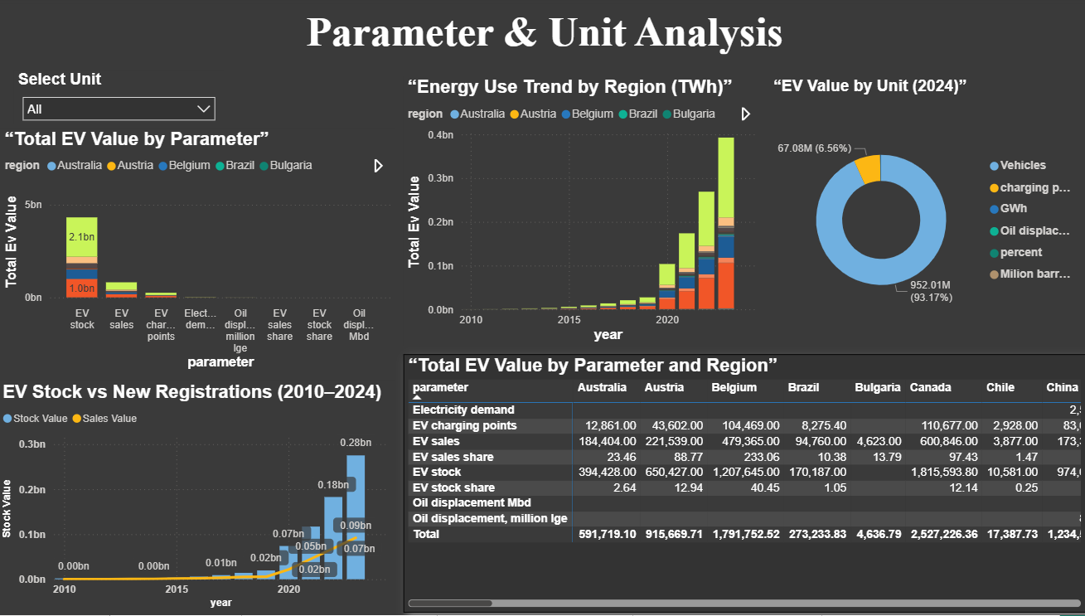
Parameter & Unit Analysis
• Stock, sales, and energy use comparison.
• Regional contributions by parameter.
• Yearly energy consumption trends.
• Stock vs. new registration changes year over year.

Slide 12
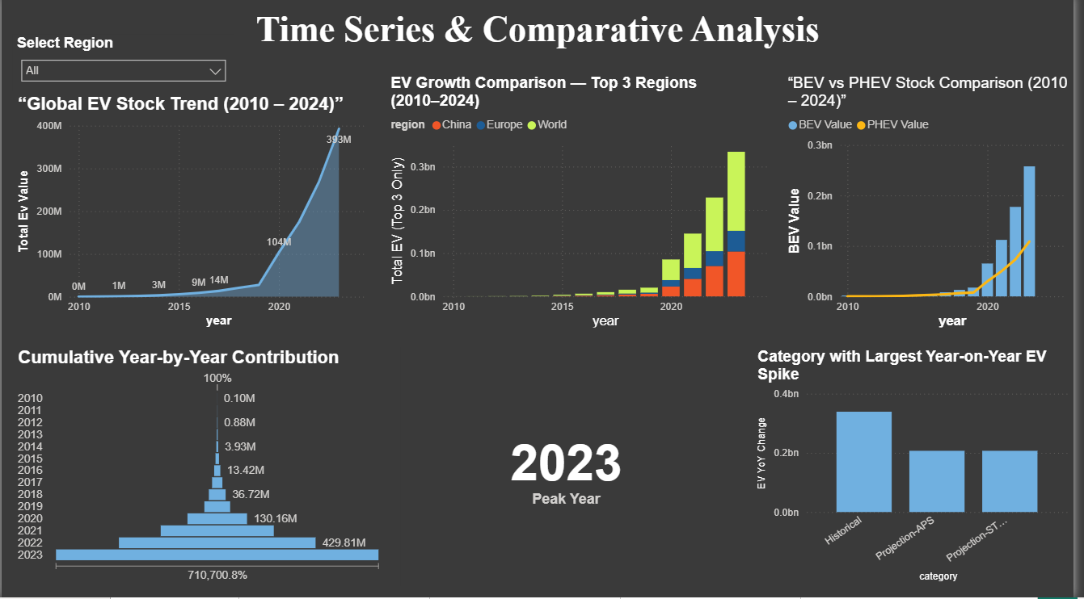
Time Series & Comparative Analysis
• Global EV stock trend (2010–2024).
• EV growth comparison for top regions.
• BEV vs. PHEV over time.
• Identifying the peak year for each region/category.

Slide 13
Key Insights & Recommendations
Key Insights :
Global EV adoption accelerated rapidly after 2015, led by Europe, China, and North America.
BEVs dominate the market since 2020, showing a shift from hybrid to full-electric.
Developed regions have achieved higher EV penetration and faster infrastructure growth.
Developing regions show strong potential — need policy support and incentives.
Energy use growth aligns with the increase in EV stock worldwide.
Recommendations :
Promote EV adoption in developing regions through government incentives and awareness.
Expand BEV charging infrastructure for accessibility and efficiency.
Encourage local manufacturing and battery recycling to reduce dependency and cost.
Support R&D for improved battery range, charging speed, and energy efficiency.
Leverage Power BI for continuous data monitoring and strategic decision-making.

Slide 14
Conclusion
The global EV market continues its strong growth trajectory. Power BI’s visual analysis highlights regional disparities, powertrain preferences, and future opportunities for sustainable transportation advancement.

Slide 15
Thank You!

